Slide 1

AT60n Introduction

Slide 2
AT60n Clear Choice® Differences & Benefits

Slide 3
Similarities and differences of AT60n versus “old AT60”
Adhesive:
Similarities: Both adhesives are acrylics and have similar adhesion levels on vinyls.
Differences: The adhesive of the AT60n is designed with a different polymerization process which makes the adhesives water resistant and helps reducing the static charges.
AT60n Clear Choice® – Differences and Benefits

Slide 4
Similarities and differences of AT60n versus “old AT60”
Films:
Similarities: The face stock of both application tapes are made from an orange peel polypropylene film with a thickness of 3.25 mil (83.5 µm).
Differences: None
AT60n Clear Choice® – Differences and Benefits

Slide 5


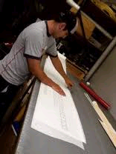

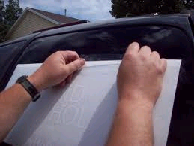
Three Stages of Application Tape
1
2
3
Lamination
Transfer
Installation
AT60n Clear Choice® – Differences and Benefits

Slide 6

Benefits of AT60n
Lamination:
Static Free for easy unwinding and a smooth handling. Signs will not “jump” to application tape.
AT60n has lay flat characterictics as the film will not absorb moisture.
Transfer:
AT60n is tested and designed for the gloss vinyls of all major vinyl brands.
AT60n Clear Choice® – Differences and Benefits

Slide 7

Benefits of AT60n
Installation:
The adhesive of AT60n is water resistant which makes the application perfectly suitable for wet applications. There will be no adhesive residues.
The transparency of AT60n film ensure a clear application tape. The clarity aids precise registration.
The rigidity of the AT60n film minimizes misalignment problems.
AT60n Clear Choice® – Differences and Benefits

Slide 8





AT60n in Facts
Static Charges are reduced - Static Free
Water resistant – No adhesive residues after wet application
Clarity – The transparency aids precise registration
Alignment – Rigidity minimizes misaligment problems
Versatility – Tested and designed for gloss vinyls of all major brands.
AT60n Clear Choice® – Differences and Benefits

Slide 9
Technical Data

Slide 10
Technical Data
 | AT60 | AT60n
Adhesive | Modified Polyacrylate | Modified Polyacrylate
Carrier – Facestock | 3.25 mil – 83 µm Clear Matte Polypropylene | 3.25 mil – 83 µm Clear Matte Polypropylene
Adhesion to steel is not fully representative for adhesion to vinyl. Application Tapes are lifting and transferring vinyl not steel. The adhesion to vinyl is very similar for both products, both application tapes have a medium tack level.
AT60n Technical Data

